Slide 1
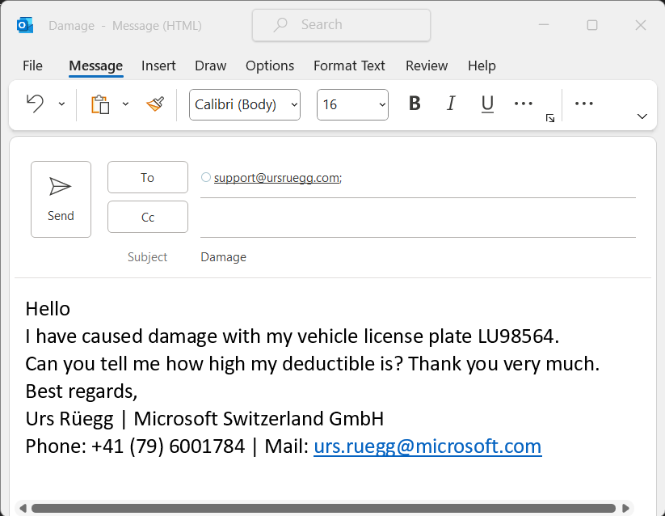



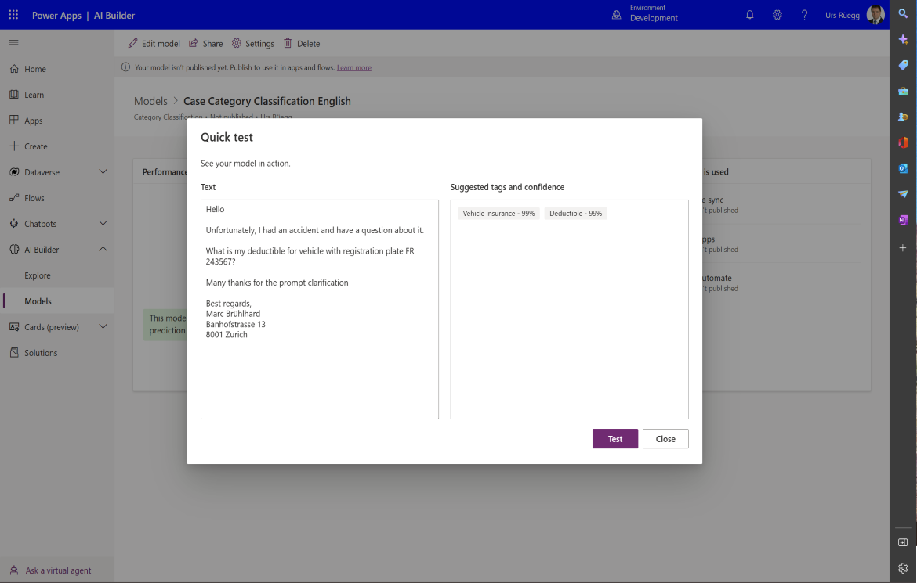
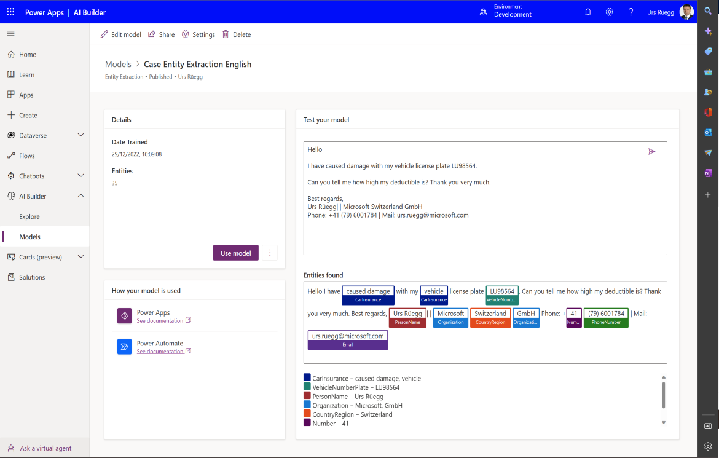

Slide 2


User
Experience
Case Process Status | Email Intake | Evaluate context | Enrich data | Routing to Queue | Research | Resolve
Power Platform MVP | Email InTake Flow using AI Builder Language detection to create Case, Contact and Email activity. | AI Builder Models Category classification to identify context and intent. Entity extraction to get Social Security No, Vehicle Plate, Policy, Products Sentiment analysis | Get details and current customer business context for Policy Claims Partner to enrich and prepare the Case for improved agent resolution. | Case Routing to route case based on rule set (Category classification, Enriched data) to either Queue (for App Users) or Email forward to another Mailbox. | Case Dashboard handling routed cases to queue and assigned to best fitting Agent to prepare and send response. | Case Dashboard to close resolved cases and analyze process improvements.
Options Custom Connectors Dynamics 365 Customer Services | Automatic record creation rule¹⁾ using AI Language detection. | Bring you own AI model using Custom Connector to integrate Customer API AI model services | Use Custom Connector to integrate Customer Application API services (Claims system, etc.) | Unified Routing and Work Distribution²⁾ of Case records to queues. Forward Email using Email Tracking³⁾ | Dynamics 365 Customer Service Case Management and Dashboard (out-of-the-box) Dynamics 365 Customer Service Insights with advanced AI technology in natural language understanding help on what matters and guide them to success.
Process
Office Outlook 365
Custom Connector
Customer API services ⁴⁾
Dataverse environment
(Contact, Email, Case, Queue)
Data
Exchange Integration ¹⁾ ³⁾

Slide 3










Automated classification
Intelligent assignment
Sentiment model
Prioritization
Customer
Intelligent skill finder (ML)
By skill
Agent
Effort estimation (ML)
By capacity / presence
+ Flows / Rules
+ Queues
Data
+
Intelligence
OPERATIONAL DATA
EMPLOYEE SIGNAL
MORE EFFICIENT OPERATIONS
MORE EFFECTIVE EMPLOYEES
CUSTOMER SIGNAL
DEEPER RELATIONSHIPS
Omnichannel engagement
Notes:
Let’s take a closer look. As you can see, unified routing has two main stages: classification and assignment.
In the classification stage, rules and machine learning (ML) models can be used to add information on the work item, which can be used to find the best-suited agent.
During the assignment stage, the service requests are prioritized and then assigned to the agent based on the nature of the work, related entities, agent skills, and the current state of the agent workforce in terms of availability and workload.
For instance, an organization receiving an incoming chat will add information on the work item—such as skills required, urgency level, category of customer, and importance level—in the classification stage, based on certain conditions that are met as part of the configured rules. In the assignment stage, an organization might want to first prioritize the incoming chats based on highest urgency level and importance, and then assign them to the agents by matching the skills required, current workload status, and availability.
What are some of the efficiency gains?
Decrease case resolution times and increase customer satisfaction by optimizing the routing strategy. Connecting end-customers with the best-suited agent drives the right outcome upon first contact.
Improve agent productivity as the right agents are being matched with the right requests. Reduce routing errors and inconsistencies as complex issues will no longer be routed to less experienced agents.
And lastly, you’ll have greater visibility to problems and pain points with actionable insights and trends into opportunities to improve agent performance and customer satisfaction

Slide 4
The Power Platform Enablement Journey
IT
Service Enablement
Service roll out
Service Transition
App in a day
Hackathon
Roadmap
Governance Model
Business
Operational Model
Technical Enablement
Onboarding
of additional
BUs/Markets
App In a day
Hackathon
Roadmap
Agile
Enlighten
MVP
Light-
house
Apps
Light-
house
Apps
Business
Sponsor
Business
Sponsor
COE
First BU/Market enabled
Transfer to Operation
COE
MVP – Minimal Valuable Product
COE – Centre of Excellence

Slide 5
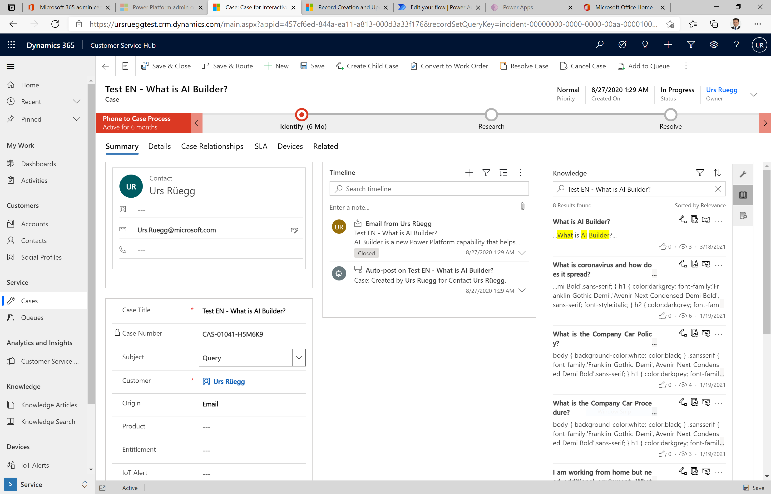
Demo – Email intake using AI models to analyze and route
Use Case – Capture Emails intake to analyze and route them to operation teams
Emails are monitored by Power Automate flow capability and convert them into cases (custom entity) and contacts (standard).
Email content analyzed based on detected language to get sentiment and topic categorization analysis, to route and assign the case to the appropriate work teams or queues.
Emails
Power Automate
Power Apps Case Management
Power AI Models 1. Language detection
2. Sentiment analysis
3. Category classification
Power AI Builder
Power AI Builder model overview Overview of prebuilt AI models - AI Builder | Microsoft Docs

Slide 6
Data model
Entity | Custom | Entity Type | Comments | Dynamics 365 CS
Case | Yes | User | Custom entity used to cover all process data from intake to close | Out-of-the-box
Case Process | Yes | User |  | Out-of-the-box
Contact | No | User | Standard contact (person) | Out-of-the-box
Email | No | Activity | Specialized activity for Emails | Including Email Tracking
Queue | No | User | Queue used to route cases to the relevant agent | Out-of-the-box
Note | No | User | Comments | Out-of-the-box
Attachment | No | User | Documents | Out-of-the-box
Organization | No | Organization |  | Out-of-the-box
Business Unit | No | Organization |  | Out-of-the-box
Users | No | Organization |  | Out-of-the-box
Security Roles | No | Organization |  | Out-of-the-box
Types of tables - Power Apps | Microsoft Docs
Solutions in Power Apps - Power Apps | Microsoft Docs

Slide 7
Data model
Contact
Note
Email Activity
Claim
Case
Attachments
….
Queue
User
Business Unit
Organization
Security Role
Types of tables - Power Apps | Microsoft Docs
Solutions in Power Apps - Power Apps | Microsoft Docs

Slide 8
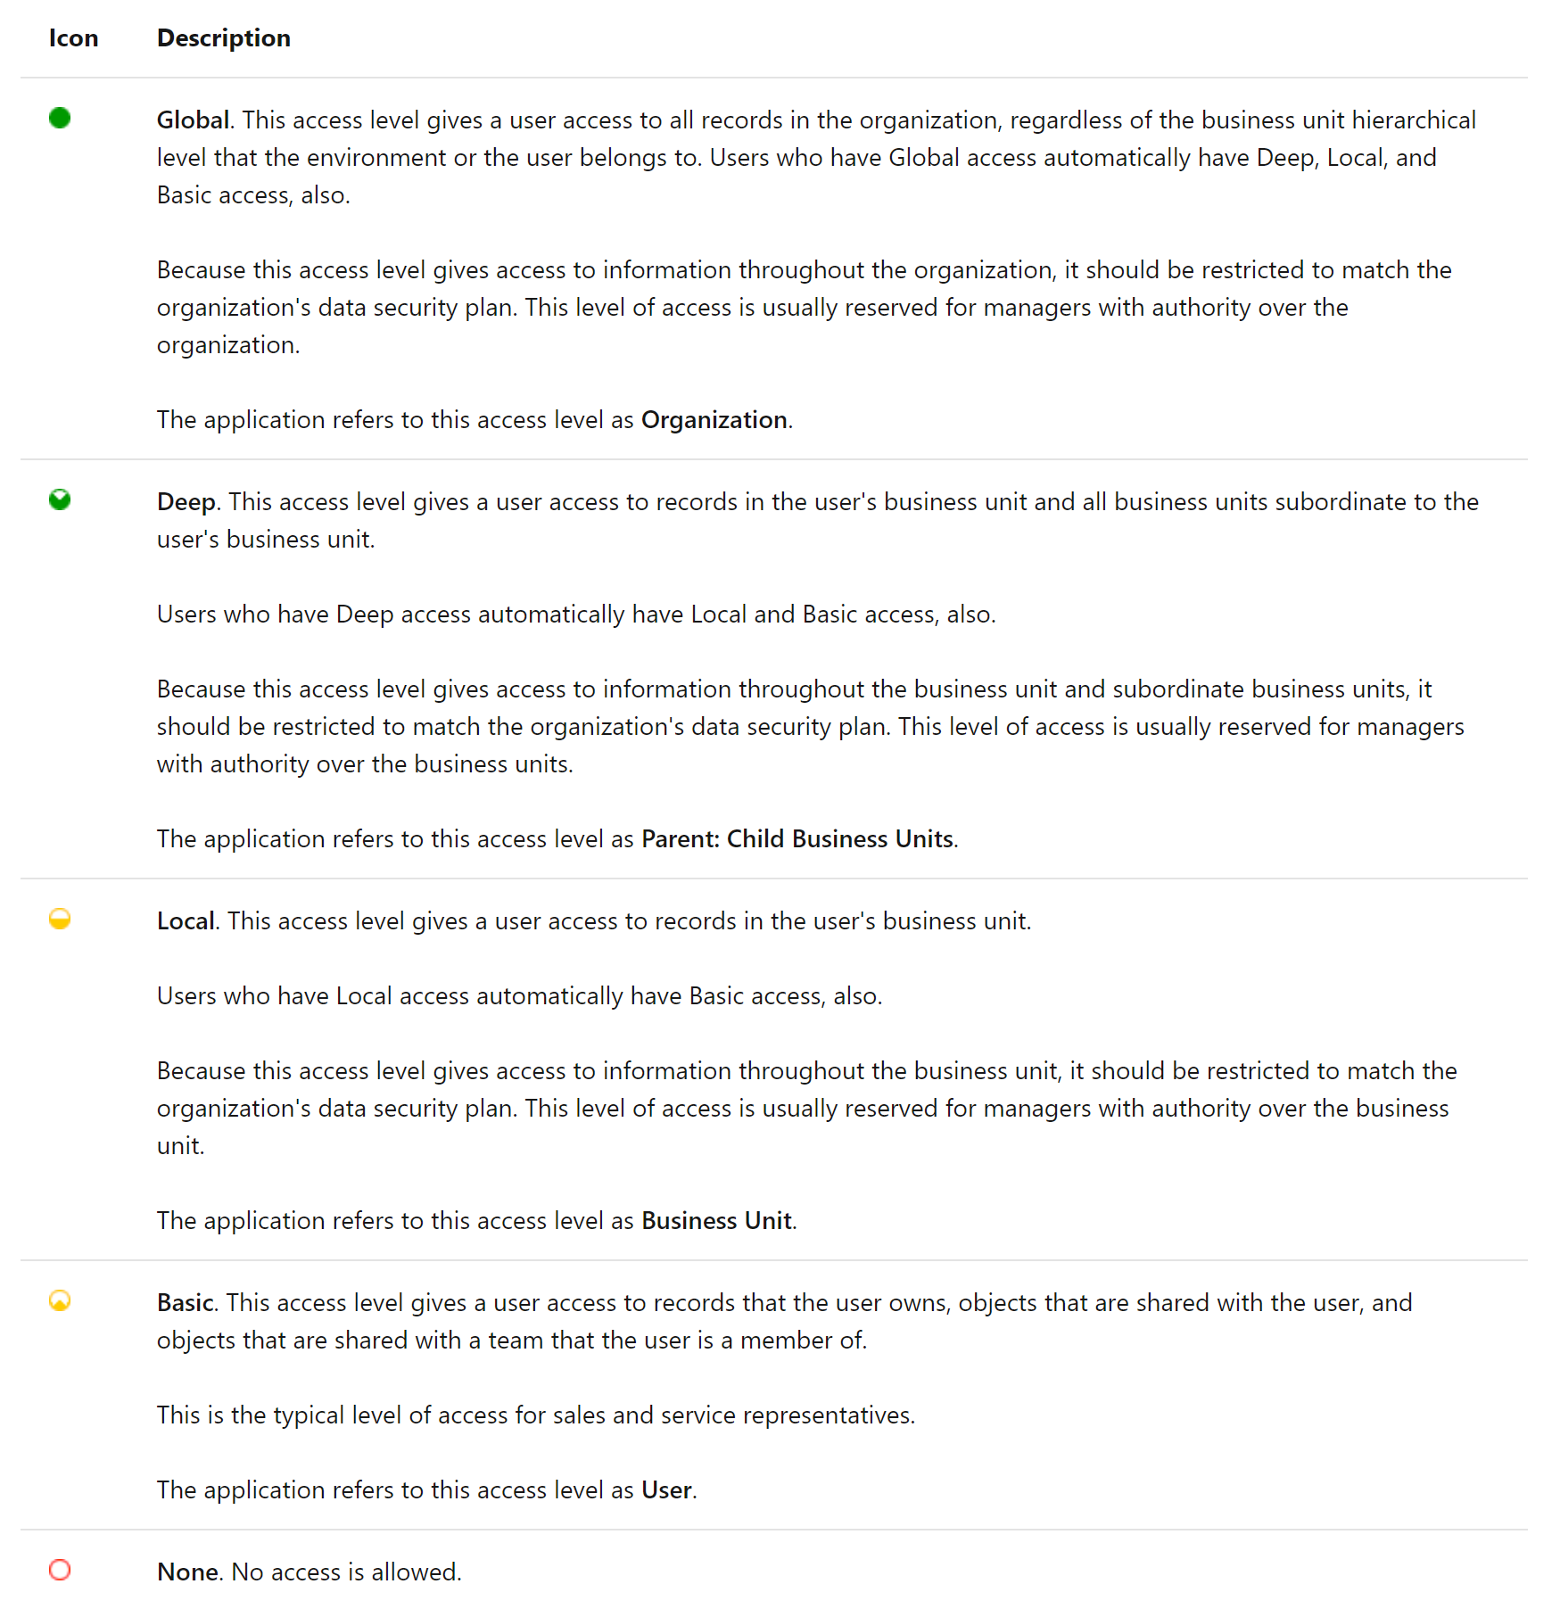
Organization structure
Administrator
Analysts
Agent
Org
QFM
BU11
BU12
GA
BU21
BU4
BU41
BU13
BU42
BU22
BU23
GB
BU31
Organization
Business Unit
Mobiliar | Power Platform | Record-level privileges
Group | Organization | Global
Company | Business Unit (Parent) | Deep, current and child
BU | Business Unit (Child) | Local, current only
User | Users (Basic) | Basic, user owned only
Authorizations | Security Roles | Based on org hierarchy
Security roles and privileges - Power Platform | Microsoft Docs

Slide 9
Functional capability blueprint
Teams “Email Triage”
User Experience
All Teams collaboration space
Agents – Model Driven app
Business Analyst - MDA
Reports (Dashboard)
Process
Business Process
Flow
Security
Environment and teams access controlled via Microsoft 365 Group
Microsoft Dataverse security roles
Connectors
Microsoft Dataverse
Custom Connector to AI Model
Office Outlook 365 (Email)
Office 365 (AD Organization)
Agent App
(Model Driven)
BA Main App
(Model Driven)
BA Reports
(Power BI)
AI Classification (Flows)
Case Process (Business Process)
Email Intake (Flows)
Microsoft Dataverse
Office Outlook 365
Control user access to environments: security groups and licenses - Power Platform | Microsoft Docs
Create a business process flow in Power Apps - Power Automate | Microsoft Docs
Install and set up the Dynamics 365 app for Microsoft Teams | Microsoft Docs

Slide 10
Make or Buy Use Dynamics 365 functionality to reduce cost to buy and maintain and accelerate implementation
Functionality | Power Platform | Dynamics 365
Email Intake | Power Automate flow using Office Outlook 365 Connector requires manually to handle Email details and attachment to create Email Activity assigned to Case. No automatic Tracking of response Email. | Automatic record creation rule supports Case, Contact and Email Activity creation including attachments and tracking of response Email
Routing to Queue | Power Automate flow maintaining the routing decision tree and case handling. | Unified Routing and Work Distribution supports rules and work distribution via Business Analyst without coding using configuration.
Forward Email using Email Tracking | Not support of Email Tracking, when forwarding Email to other users/teams mailbox. | Dynamics 365 Outlook app supports Email tracking and context within Outlook.
Case Management | Power Apps requires custom build of Model Driven app and Case to maintain the process | Dynamics 365 Customer Services includes Case Management closed loop management out-of-the-box
Security Roles | Power Apps requires custom build of Security Roles to ensure access permission. | Dynamics 365 Customer Service includes predefined security roles for Agent and Service Owners.

Slide 11
User Experience
Email Intake Flow
New Email received
Check by Sender Email if Contact exists
Create new Contact
Create new Case
Create new Email activity
Check Email Body Language
Update Case with Language and confidence score and Status
Enrich Contact with Business data
Analyze Email Intent
Email Intent Classification
Email Sentiment Analysis
Email Entity Classification
Check auto response
Create and send auto response
If no auto response, check routing rule and assign case to queue
Agent
Dashboard daily work
New Case assigned to Queue
Analyze response
Assign to another Agent
Send response Email
Close case as resolved
Analyst
Dashboard closed loop review
Prediction analysis
Auto resolve
Re-Train model
Refine auto resolve
Refine routing

Slide 13
Power Platform based - Licensing estimation
Pricing | Microsoft Dynamics 365
Requests limits and allocations - Power Platform | Microsoft Docs
AI Builder Calculator | Microsoft Power Apps
Assumptions
500'000 Mails per year, 160 Agents managing responses, 10 Business Analysts managing process & models, 3 AI models used
Users | Quantity / # of users | Per Month | Product | Price/user/month in € | Total in €
Employee | 5’000 |  | Office 365 Outlook (Microsoft 365 E3/E5) | - | -
Agent | 160 |  | Power App per User (SEJ-00002) | 30.70 | 4’912.00
Business Analyst | 10 |  | Power App per User (SEJ-00002) | 30.70 | 307.00
Capacity
Power Automate API calls | 500’000 | 41’667 | Power Apps includes API calls per day - Power App = 5’000 | 0.00 | 0.00
AI Builder used models Language detection Category classification Entity extraction | 500’000 | 41’667 | AI Builder add-on 41’667 Mails per month * 3 models requires 4 units of capacity | 383.70 | 1’534.80
Total in € |  |  |  |  | 6’753.80
Enterprise 6 Net Prices for Eurozone, Corporate, Direct To End User, in 2021-06 in Euro valid until June 30, 2021.
© 2021 Microsoft Corporation. All rights reserved. Microsoft, Windows and other product names are or may be registered trademarks and/or trademarks in the U.S. and/or other countries.
The information herein is for informational and discussion purposes only and represents the current view of Microsoft Corporation or any Microsoft Group affiliate as of the date of this presentation. Because Microsoft must respond to changing market conditions, it should not be interpreted to be a commitment or binding offer or acceptance of any warranties, liabilities, wrongdoing etc. on the part of Microsoft, and Microsoft cannot guarantee the accuracy of any information provided after the date of this presentation. MICROSOFT MAKES NO WARRANTIES, EXPRESS, IMPLIED OR STATUTORY, AS TO THE INFORMATION IN THIS PRESENTATION.

Slide 14
Dynamics 365 & Power Platform based - Licensing estimation
Pricing | Microsoft Dynamics 365
Requests limits and allocations - Power Platform | Microsoft Docs
AI Builder Calculator | Microsoft Power Apps
Assumptions
500'000 Mails per year, 160 Agents managing responses, 10 Business Analysts managing process & models, 3 AI models used
Users | Quantity / # of users | Per Month | Product | Price/user/month in € | Total in €
Employee | 5’000 |  | Office 365 Outlook (Microsoft 365 E3/E5) | - | -
Agent | 160 |  | Dynamics 365 Team Member | 6.14 | 982.40
Business Analyst | 10 |  | Dynamics 365 Customer Service | 72.90 | 729.00
Capacity
Power Automate API calls | 500’000 | 41’667 | Dynamics 365 includes API calls per day - Customer Service = 20’000 - Team Member = 5’000 | 0.00 | 0.00
AI Builder used models Language detection Category classification Entity extraction | 500’000 | 41’667 | AI Builder add-on 41’667 Mails per month * 3 models requires 4 units of capacity | 383.70 | 1’534.80
Total in € |  |  |  |  | 3’246.20
Enterprise 6 Net Prices for Eurozone, Corporate, Direct To End User, in 2021-04 in Euro valid until April 30, 2021.
© 2021 Microsoft Corporation. All rights reserved. Microsoft, Windows and other product names are or may be registered trademarks and/or trademarks in the U.S. and/or other countries.
The information herein is for informational and discussion purposes only and represents the current view of Microsoft Corporation or any Microsoft Group affiliate as of the date of this presentation. Because Microsoft must respond to changing market conditions, it should not be interpreted to be a commitment or binding offer or acceptance of any warranties, liabilities, wrongdoing etc. on the part of Microsoft, and Microsoft cannot guarantee the accuracy of any information provided after the date of this presentation. MICROSOFT MAKES NO WARRANTIES, EXPRESS, IMPLIED OR STATUTORY, AS TO THE INFORMATION IN THIS PRESENTATION.

